Slide 1
SmartSecurity
Team members:
Tyler Harclerode - Project coordinator
Brandon lin - Hardware/software integration
Zachary Davoli - mobile application development
Jonathan Griffin – network engineering

Slide 2
Purpose:
All-in-One security system for personalized residential or commercial use
Live camera feed + sensor alerts with customizable boundary values
Peace of mind for the modern family or business

Slide 3
Presentation Overview
Project outline
Hardware components
Software components
How it works
Project challenges & obstacles
Project outcomes
References

Slide 4
Project Outline
Show block diagram
Show produced readings (sensor values, camera readings, etc.)
Give example uses

Slide 5
Hardware
Raspberry Pi 3 Model B (computer with network connection)
PIR Motion Sensor (pyroelectric infrared motion detection)
DHT11 (temperature & humidity)
MQ-7 (carbon monoxide sensor)
LCD1602 (device display)
Makerfocus Video Camera (security camera with night vision)
4x4 Matrix Keypad (PIN and boundary value entry)
Alarm Buzzer

Slide 6
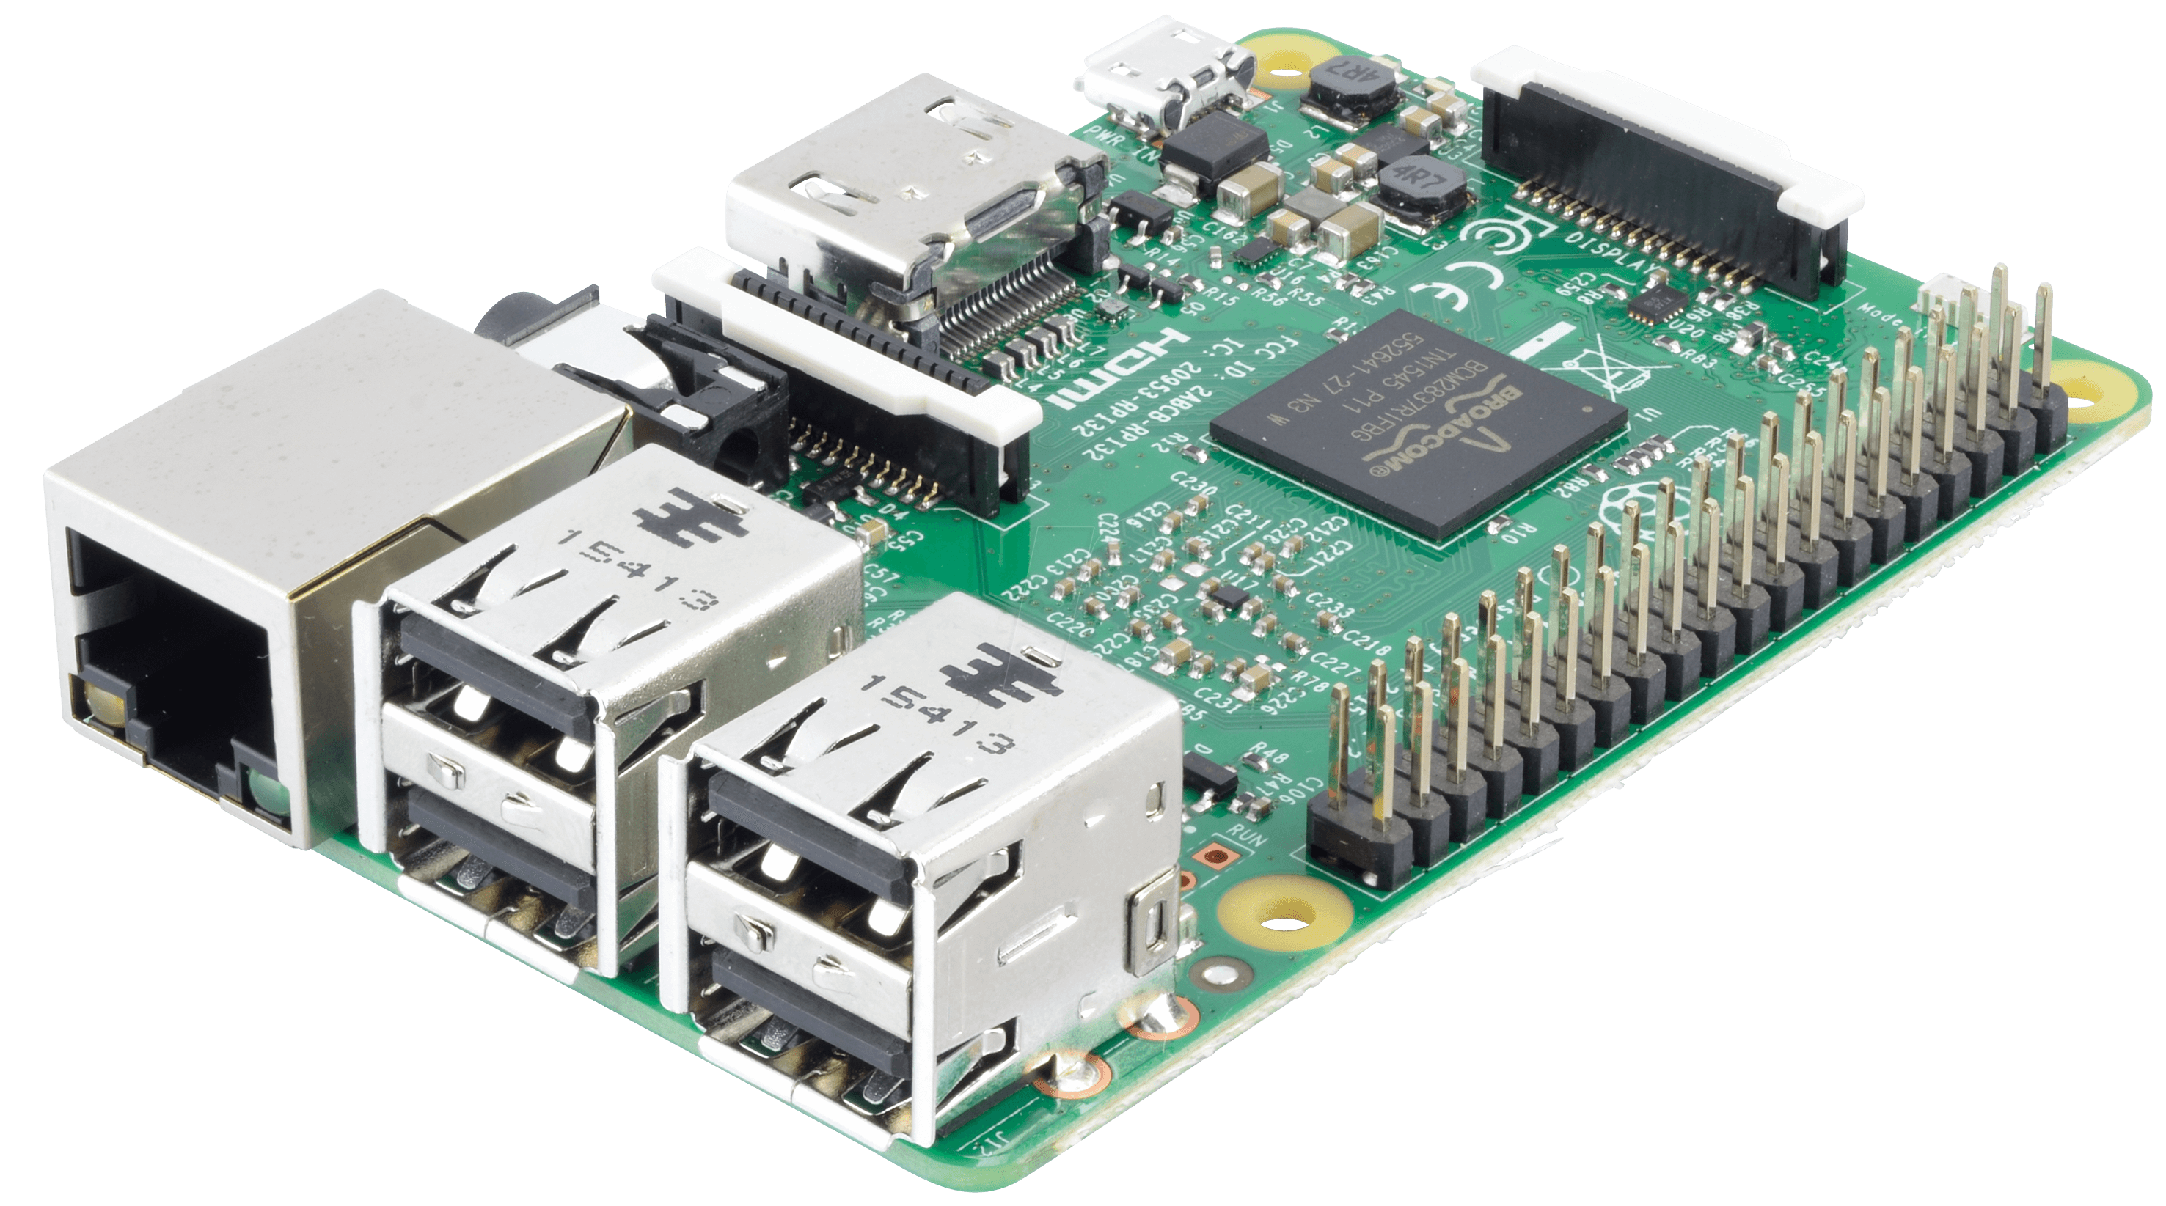
Raspberry Pi 3 Model B
Runs embedded system software
Integrates hardware
Wi-fi and Bluetooth connectivity

Slide 7
PIR Motion Sensor

Slide 8
DHT11

Slide 9
MQ-7

Slide 10
LCD1602 Display

Slide 11
Makerfocus Video Camera

Slide 12
4x4 Matrix Keypad

Slide 13
Alarm Buzzer

Slide 14
Software
Security system states & purposes
Sensor classes
Python networking
Mobile application
Database

Slide 15
Security System States & Purposes
0 = Inactive security system
1 = Active security system awaiting motion or user alert
2 = Awaiting user response upon warning (picture sent to app)
3 = System alarm buzzing, camera feed recorded

Slide 16
Sensor Classes
Set boundary values
Call sensor readings
Display data to LCD and mobile application
Store recordings in database

Slide 17
Python Networking
Listening
Accepting
Socket utilization
Speaking through server

Slide 18
Mobile Application
User interface
Security monitorization
Server connectivity
Sensor readings

Slide 19
Database
Recorded sensor readings
User profile & info log
Camera captures and recordings
Network data allocation

Slide 20
How It Works
System initialization
Embedded system software overview
Networking and connectivity
Application interface

Slide 21
Project Challenges & Obstacles
Project redefinition
Limitations of using single MCU
Project ambiguity
Time constraints

Slide 22
Project Outcomes
Complete | Incomplete | Future Modifications
Sensor readings with respect to boundaries | Camera movement through stepper motor | Additional stand-alone cameras connected
 |  | Touch screen display
 |  | Better sensors

Slide 23
Computer Science Outcomes
Familiarity and experience with mobile application development
Android Development Studio
Java
Experience with embedded system software usually found in CET
Python programming experience [alongside CSC-308]
Networking experience
Software Engineering principles in practice
Indirectly address any other necessary CSC Student Outcomes

Slide 24
Computer Engineering Outcomes
Server experience with networking
Embedded system software experience
Hardware testing experience
Executing hardware with newly learned software (Python programming)
Familiarity and experience with a new microcontroller (Raspberry Pi 3 Model B)
Indirectly address any other necessary CET Student Outcomes

Slide 25
References

Slide 26
Questions?

